Slide 1


Unit 6.2.2 – IoT Architecture

Slide 2

Unit Goal
This unit aims to introduce the different architecture types in IoT. After this unit, students will be able to identify several IoT architectures to select the type that fits better to a specific problem.

Slide 3
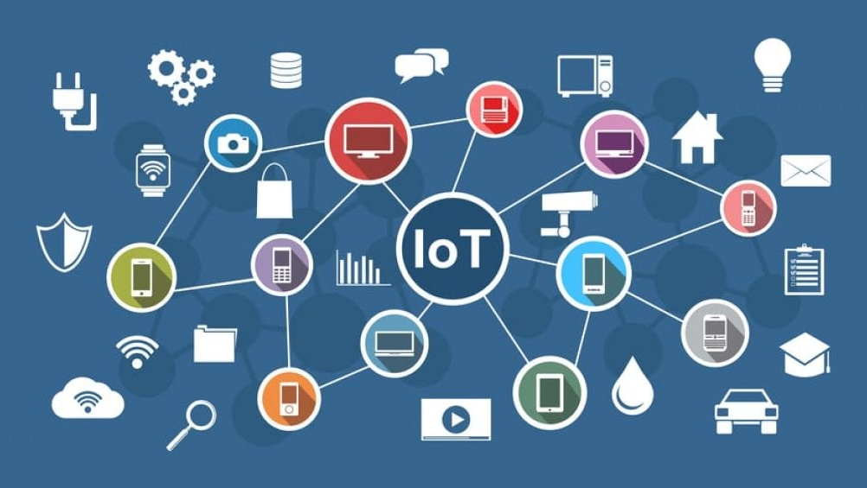
IoT Review

Slide 4
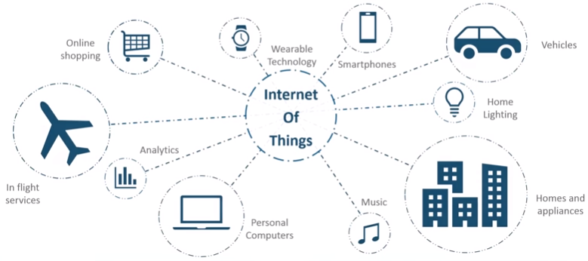
What is IoT?
IoT is an advanced automation and analytics system which deals with artificial intelligence, sensor, networking, electronic, cloud messaging, etc. to deliver complete systems for the product or services. The system created by IoT has greater transparency, control, and performance.

Slide 5
IoT Architecture Overview

Slide 6
Why do I need an architecture?
The concept behind the Internet of Things is as powerful as it is complex, and for the elements in the IoT puzzle to mesh perfectly, they all must be part of a well-thought-out structure.
This is where IoT architecture enters the stage, especially in IoT device management.
While every IoT system is different, the foundation for each Internet of Things architecture and its general data process flow is roughly the same.

Slide 7
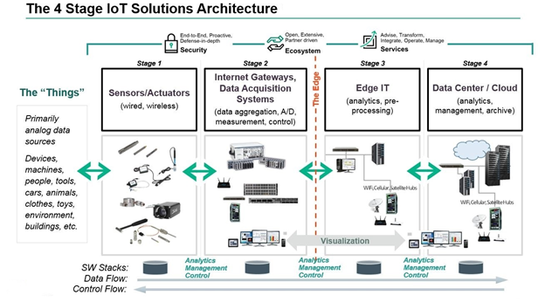
4 Stage IoT Architecture

Slide 8
Things, Sensors and Actuators

Slide 9
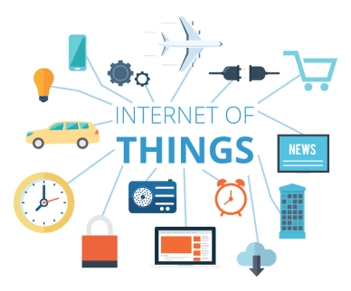
Things, Sensors and Actuators
Sensors or Actuators are the devices that can emit, accept and process data over the network.
These sensors or actuators may be connected either through wired or wireless.
This contains GPS, Electrochemical, Gyroscope, RFID, etc. Most of the sensors need connectivity through sensors gateways.
The connection of sensors or actuators can be through a Local Area Network (LAN) or Personal Area Network (PAN).

Slide 10
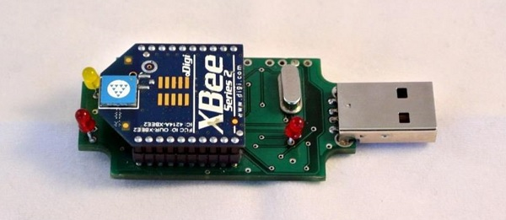
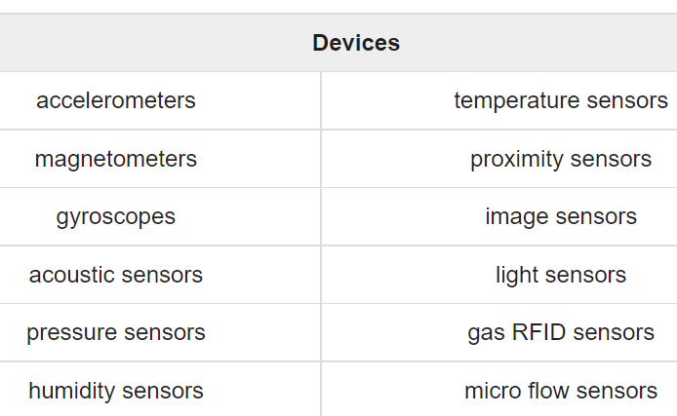
Not Smart Objects
Sensors are electronic devices composed of sensitive cells that are able to measure physical parameters like the light fluctuation using a photoresistor, the temperature using a thermistor, to detect flames, sounds, movements, or any other fluctuation in the environment.

Slide 11
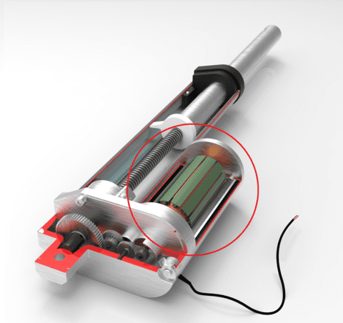
Not Smart Objects
Actuator is a component of a machine that is responsible for moving and controlling a mechanism or system, for example by opening a valve.

Slide 12
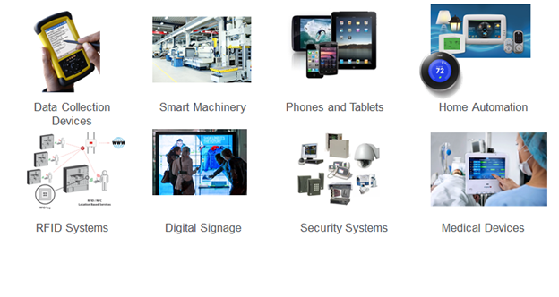
Smart Objects
A smart object is an object that enhances the interaction with other smart objects as well as with people also. It is compound by sensors and actuators.

Slide 13
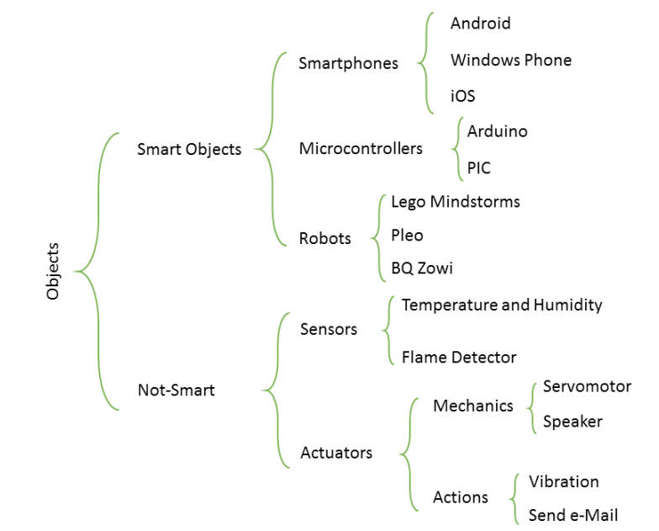
Smart Objects Summary

Slide 14
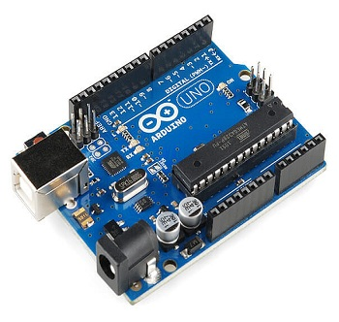
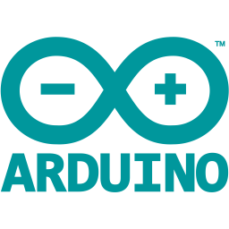
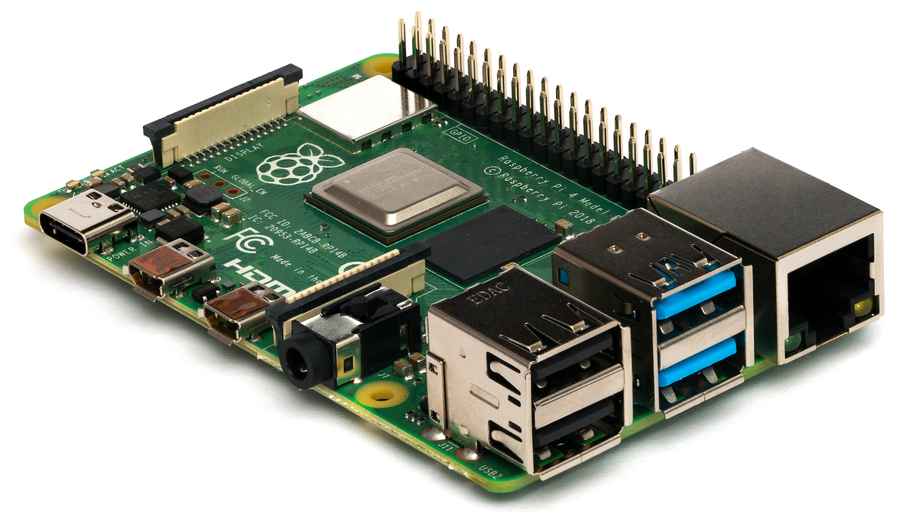
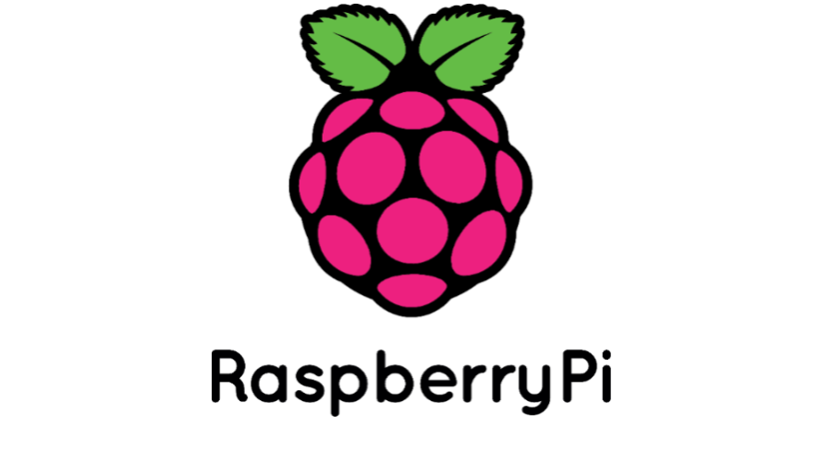
IoT Devices
Arduino Device: the microcontrollers and microcontroller kit for building digital devices that can be sense and control objects in the physical and digital world. Arduino boards are furnished with a set of digital and analog input/output pins that may be interfaced to various other circuits.
Raspberry Pi is a series of small single-board computers developed in the United Kingdom by the Raspberry Pi Foundation in association with Broadcom.

Slide 15

10 Most Advanced IoT Devices In The World
https://www.youtube.com/watch?v=nvOYlB6z6MM

Slide 16
Gateways and Data Acquisitions

Slide 17
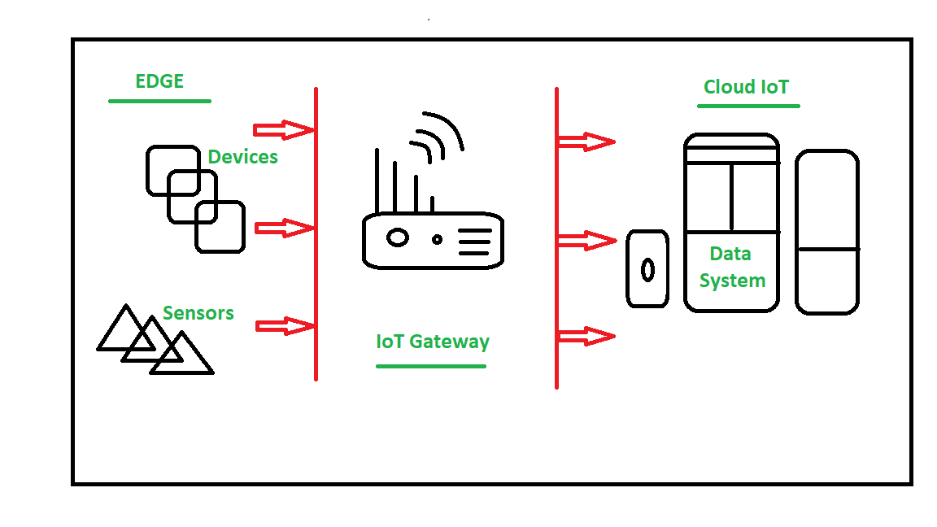
Gateways and Data Acquisitions
Gateway provides bridge between different communication technologies, which means that it acts as a medium to open connection between cloud and controller(sensors / devices) in Internet of Things (IoT).

Slide 18
Gateways and Data Acquisitions
It enables a connection between sensor network and Internet along with enabling IoT communication.
It performs many tasks: protocol translation, aggregating all data, local processing and filtering of data before sending it to cloud, locally storing data and autonomously controlling devices based on some inputted data, providing additional device security.
This network can be of type Local Area Network (LAN such as WiFi, Ethernet, etc.), Wide Area Network (WAN such as GSM, 5G, etc.).

Slide 19
Edge IT

Slide 20
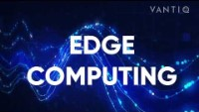
What is Edge Computing and How Does it Work?
https://www.youtube.com/watch?v=hs3yqZySweI

Slide 21
Edge IT
Edge in the IoT Architecture is the hardware and software gateways that analyze and pre-process the data before transferring it to the cloud.
If the data read from the sensors and gateways are not changed from its previous reading value then it does not transfer over the cloud, this saves the data used.

Slide 22
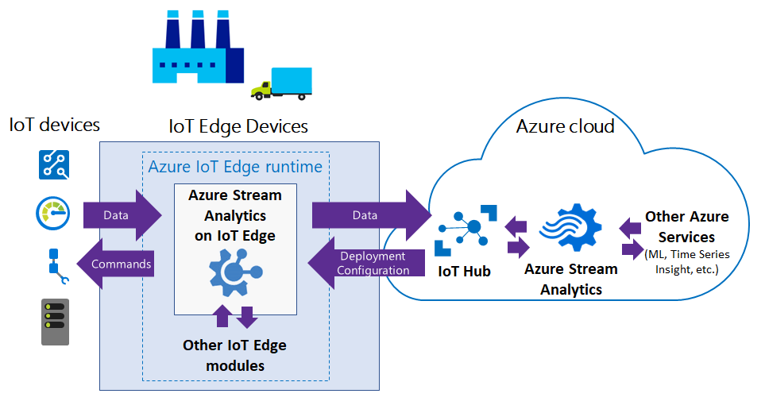
Edge

Slide 23
Edge
As edge infrastructure can be located closer to the data source in physical terms, it is easier and quicker for it to act on the IoT material in real time and provide output in the form of instant actionable intelligence.
In this scenario, only the larger chunks of data which really need the power of the Cloud to be processed are forwarded there.
By minimizing network exposure, security can be significantly enhanced, while reduced power and bandwidth consumption contributes to more efficient leveraging of business resources.

Slide 24
Edge Benefits
decrease the cloud network load
reduce the transmission cost of the data
real-time response to “things”
provide monitoring of IoT devices and their activities

Slide 25
Data Center/ Cloud

Slide 26
Data Center/ Cloud
The Data Center or Cloud comes under the Management Services which process the information through analytics, management of device and security controls.
If sensors are neurons and the gateway is the backbone of IoT, then the cloud is the brain on the Internet of Things body.
Contrary to edge solutions, a data center or a cloud-based system is designed to store, process and analyze massive volumes of data for deeper insights using powerful data analytics engines and machine learning mechanisms which edge systems would never be able to support.

Slide 27
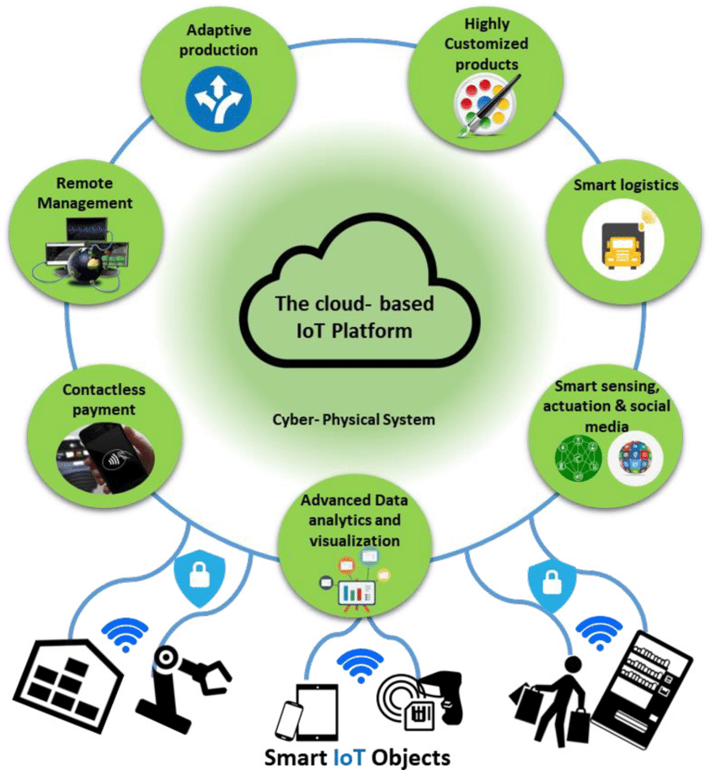
Cloud-based IoT Platform
Cloud computing is a model for enabling convenient, on-demand network access to a shared pool of configurable computing resources that can be rapidly provisioned and released with minimal management effort or service provider interaction.

Slide 28
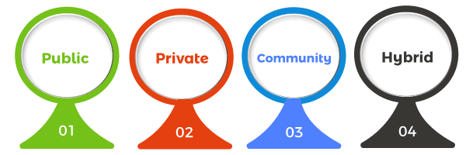
Type of Clouds
Public cloud infrastructure is entirely owned, managed, and maintained off-site via the internet by third-party service providers such as Amazon, Microsoft, or Google. With a public cloud, service providers rent out their computing resources, like servers, storage, and applications, to various organizations, ensuring availability to anyone who wants to use or purchase them.
Hybrid Cloud infrastructure combines elements from private and public deployments, offering the robust security of a private cloud and the additional storage and cost-effectiveness of a public cloud. However, infrastructure is complex and requires highly technical expertise to install, manage, and maintain due to the evolving mix of public and private clouds.
Community clouds are shared by enterprises with common operational and regulatory concerns, such as trade associations, non-profits, and government agencies. A community cloud is a suitable deployment option for organizations that need a cost-effective way to collaborate on joint projects, applications, or research. Community clouds provide a cheaper alternative to private clouds since the operating and maintenance costs are divided among the cloud tenants. This model is hosted either on-site or off-site and owned by one or more organizations in the community or by a cloud services provider.

Slide 29
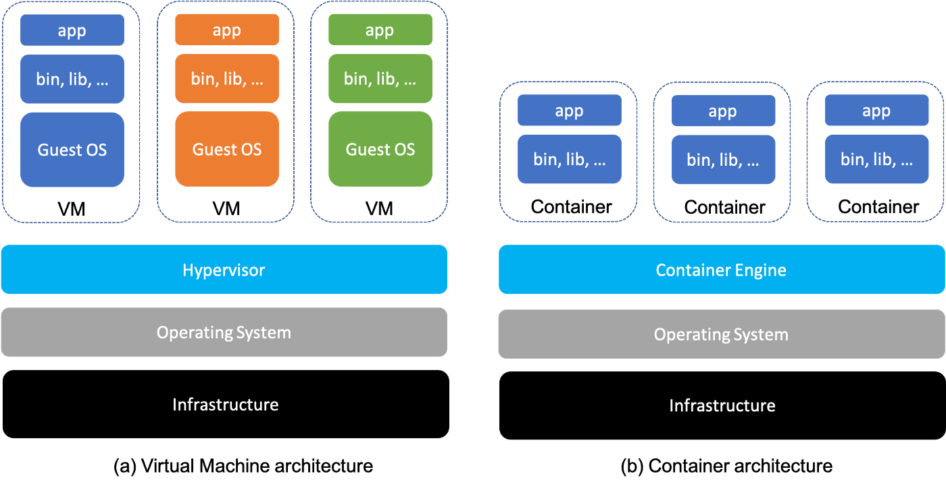
Virtualization
Virtualization is the act of creating a virtual (rather than actual) version of something, including virtual computer hardware platforms, storage devices, and computer network resources.

Slide 30
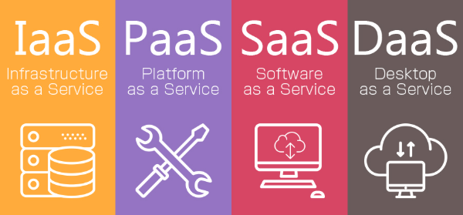
Cloud-based Services Models

Slide 31
Infrastructure as a Service (IaaS) allows delivering computer infrastructure on an outsourced basis in order to support enterprise operations. This service model is based on the paradigm of virtualization of resources.
Platform as a Service (PaaS) provides a platform allowing customers to develop, run, and manage applications. It removes the complexity of building and maintaining the infrastructure typically associated with developing and deploying an application.
Software as a Service (SaaS) is a software licensing and delivery model in which software is licensed on a subscription basis and is centrally hosted. It is sometimes referred to as “on-demand software”. SaaS is typically accessed by users using a thin client via a web browser.

Slide 32
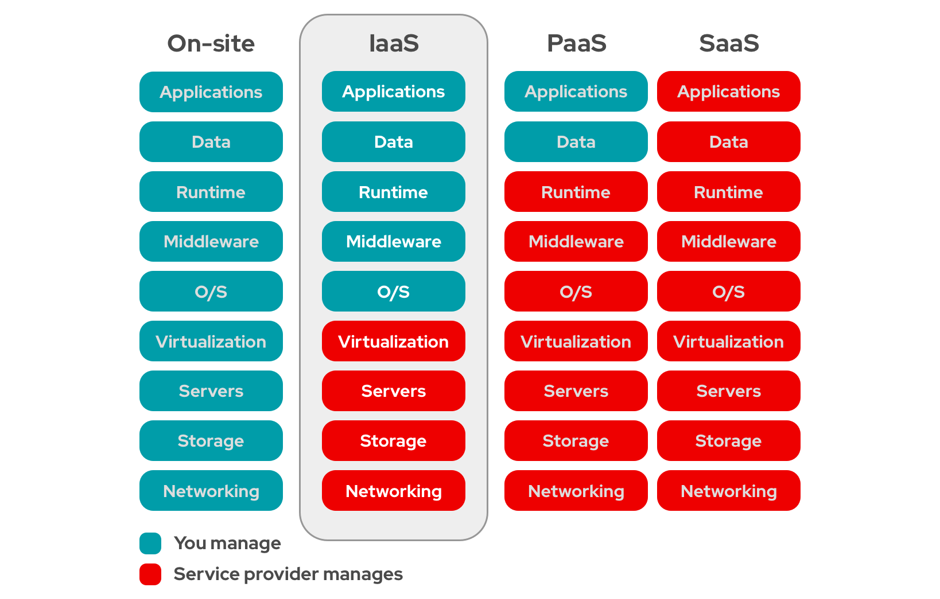

Slide 33
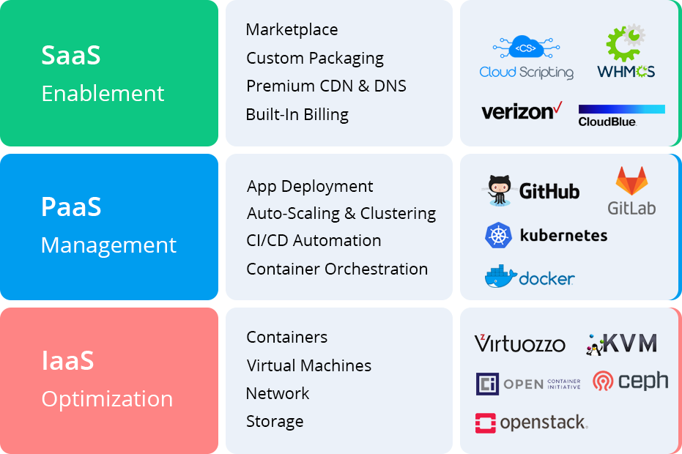

Slide 34
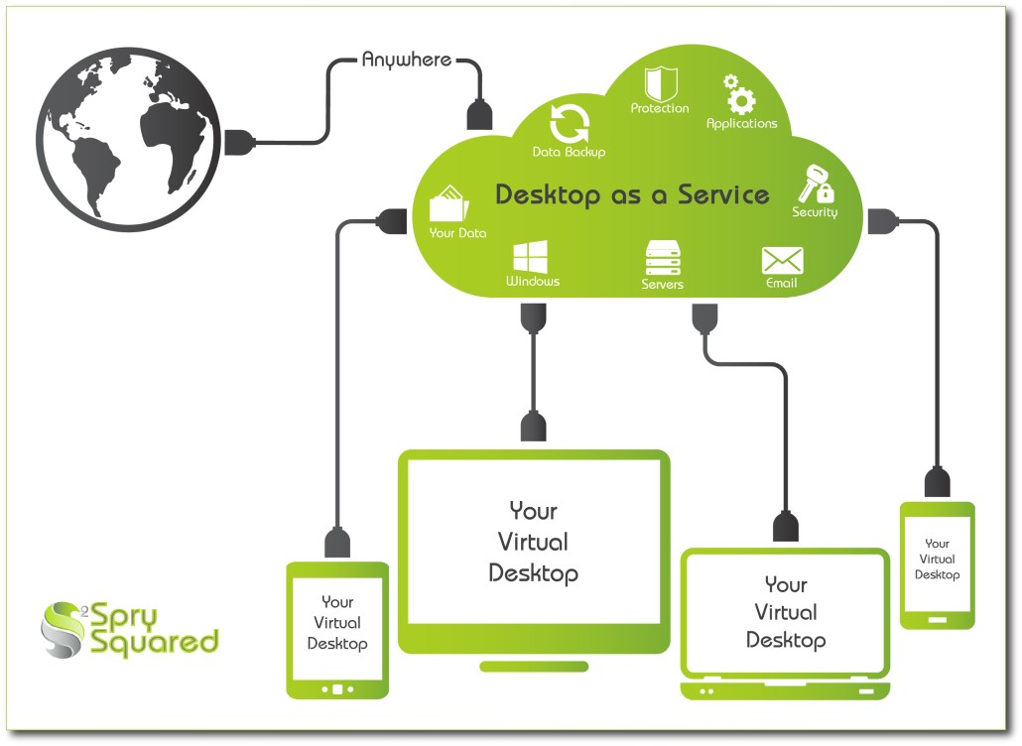
Desktop as a Service (DaaS)
Desktop as a Service (DaaS) is a cloud computing offering where a service provider delivers virtual desktops to end users over the Internet, licensed with a per-user subscription.

Slide 35
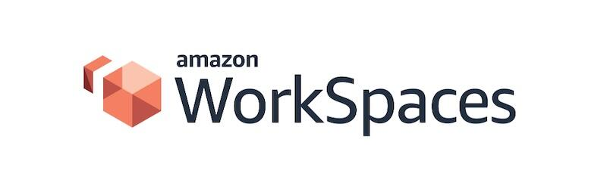
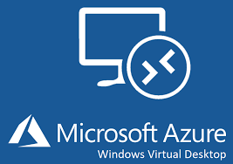
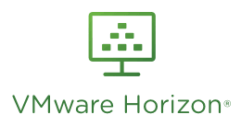
Desktop as a Service (DaaS)

Slide 36
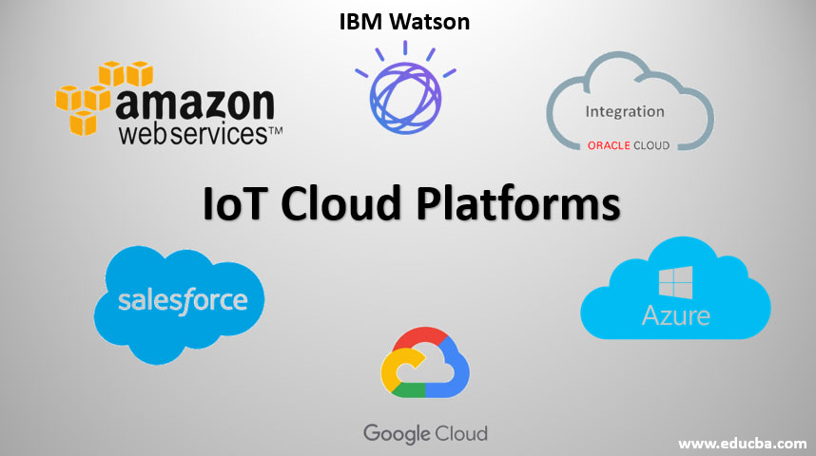
Cloud-based IoT Platform

Slide 37
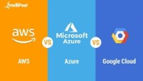
AWS vs Azure vs GCP | Amazon Web Services vs Microsoft Azure vs Google Cloud Platform https://www.youtube.com/watch?v=n24OBVGHufQ

Slide 38
Unit 6.2.2 – IoT Architecture

